Slide 1
What is this slide pack?
These slides are for you to use inside your organisation to communicate Perseus, helping you to secure internal understanding, excitement and buy-in.
They cover
Goals and ultimate vision
Value of Perseus for different actors
The case for being involved early
Who else is involved
How the value chain works
Pilot progress
Feel free to use them as they are, make a copy and adapt/delete slides for your audience, or put the content into your own template.

Slide 2
PERSEUS

Slide 3
What does Perseus aim to achieve, and who benefits?
1

Slide 4
Vision
Perseus will help unlock access to finance that reduces emissions, by automating sustainability reporting for every SME business in the UK.

Slide 5
First-phase ambition: SME electricity data
In its first phase, Perseus will automate access to assurable SME electricity data. SMEs will be able to see the emissions from this energy use and share it, via reporting solutions, to their banks to unlock green finance.
Long-term ambition: transforming finance that reduces emissions
Expanding data sets
The next stage of Perseus development will cover gas - meaning Perseus will cover the material part of Scope 1 emissions as well as Scope 2
Future phases will include water and beyond as determined by and for its commercial members
Transforming lending
Our collective ambition is to help make all lending green: where all loans are measurable, have a carbon value, and have personalised recommendations for interventions
This would be as part of default, business-as-usual data flows (e.g. XBRL)
A collaborative effort to help lenders green their entire portfolio

Slide 6
“
Imagine a small logistics business that wants to install solar panels.
Today, it's likely to find it surprisingly hard to access green finance to help - and it’s already drowning in requests for information and compliance.
With Perseus, the business’s bank will have access to assurable data about the day-to-day energy the business uses. It feeds into the bank's due diligence process to make sure the SME qualifies for a green loan - and lowers the risk of granting it.
In the short-term, it just takes one click for the SME to share data with a carbon accounting application and their bank - meaning a faster, easier loan process so it can install the solar panels sooner.
In the long-term, this will give lenders the confidence to lend more - meaning that small logistics business will have a bigger, better range of green finance to choose from for their next upgrade.
“

Slide 7
Perseus will open up lending product opportunities that benefit lenders, SMEs, and carbon accounting providers
Use of proceeds
Perseus automates access to reasonably assured data, helping assign evidence to loans
Perseus can slot into existing products (eg asset related)
Agreed priority by AG1
Sustainability Linked Loans
Perseus helps verify emissions reduction through smart meter and grid intensity data
Could enable interest rate reduction (e.g. 15 BIP) upon verified emissions reduction (e.g. 20%)
Lowers SME financing costs; enables verifiable impact for banks
Agreed priority by AG1
The next phase of Perseus will focus on gas consumption, opening up more product opportunities
Relevant to Retrofit Loans, Working Capital Loans, Impact-Linked Loans. Covering natural gas, LPG, biomass. Regulatory drivers are GHG Protocol, CSRD, SECR.

Slide 8
Perseus will open up lending product opportunities that benefit lenders, SMEs, and carbon accounting providers
More detailed version of slide 7- delete if not needed
Product | Priority | Use Case | Perseus Role | Loan Mechanics | Benefit | UK TAM (£M)
Use of proceeds | 1 | Where Perseus can slot into existing products (ie. asset-related) | Automate access to reasonably assured data | Help assign evidence | TBC
Sustainability-Linked Loan (SLL) | 2 | General SME decarbonisation projects (e.g. energy-efficient machinery, solar panels) | Helps verify emissions reduction through smart meter and grid intensity data | Interest rate reduction (e.g. 15 BIP) upon verified emissions reduction (e.g. 20%) | Lowers SME financing costs; enables verifiable impact for banks | 1,600
Pay-for-Performance Retrofit Loan |  | Retrofits for commercial buildings or facilities | MRV to assess pre- and post-retrofit emissions using half-hourly energy data | Disbursements or interest rates tied to performance improvements | Mitigates performance risk; supports climate-linked building upgrades | 480
Green Equipment Leasing |  | Leasing EVs, solar kits, energy-efficient appliances | Verifies energy and emissions savings during usage | Variable lease rates based on verified usage and emissions reductions | Encourages uptake of sustainable assets; supports leasing market | 320
Carbon-Linked Working Capital Loan |  | Finance tied to operational emissions improvements | Provides verified monthly or quarterly carbon reporting from energy data | Interest rate or access tied to carbon performance trends | Aligns operational finance with sustainability outcomes | 160
ESG Trade Finance (Scope 3-Aligned) |  | Supplier finance for low-carbon supply chains | Tracks supplier emissions and verifies carbon data | Preferential terms for suppliers with low or improving emissions intensity | Supports value chain decarbonisation; de-risks Scope 3 reporting | 240
Impact-Linked Development Loan |  | Outcome-based disbursement in blended or public finance | MRV emissions outcomes with audit-ready provenance | Capital unlocked when verified outcomes are met | Supports policy-compliant impact finance and tax-linked incentives | 80
agreed
agreed
Perseus could help make all lending green (ie. all loans are measurable, and have personalised recommendations for interventions)
** estimates for the purposes of discussion only, derived from BBB, UKF, DESNZ and related sources
v2025-04-23
PRODUCT INNOVATION

Slide 9
Moving beyond electricity will open up more lending product opportunities
More detailed version of slide 7- delete if not needed
Data Type | Priority | Relevance to Products | GHG Scope(s) | Regulatory Drivers | Integration Source(s)
Gas Consumption (Natural Gas, LPG, Biomass) | High | Retrofit Loans, Working Capital Loans, Impact-Linked Loans | Scope 1 | GHG Protocol, CSRD, SECR | Smart Gas Meters, Utility APIs, Building Management Systems
Fuel Use & Vehicle Telematics | High | Equipment Leasing, Trade Finance, Working Capital Loans | Scope 1, Scope 3 | GHG Protocol, SBTi, CSRD | Fuel Cards, Telematics Platforms, DVLA
Business Premises Metadata | High | Retrofit Loans, Property-Linked Finance | Supports Scopes 1 & 2 baselining | ESOS, EPC, Local Retrofit Standards | EPC Register, Ordnance Survey, Land Registry
Tariff and Billing Data | High | All Perseus-Linked Loans | Supports Scope 2 financial calculations | PCAF, SECR, CSRD | Energy Suppliers, Aggregators
Procurement & Supplier Data | Medium | Trade Finance, Working Capital Loans | Scope 3 (Category 1) | GHG Protocol, Scope 3 Standards, CSRD | Accounting Platforms (e.g. Xero, Sage), Procurement Systems
Product/Service Carbon Intensity | Medium | Impact-Linked Loans, ESG Reporting | Scope 3 (Category 11: Use of Sold Products) | GHG Protocol Product Standard, PCAF | LCA Databases, Carbon Accounting Providers
Staff/Travel Activity | Medium | Working Capital Loans, ESG Reporting Services | Scope 3 (Categories 6 & 7) | GHG Protocol, CSRD | HR Systems, Expense Reporting, Travel Platforms
Waste Generation & Water Use | Medium | Retrofit Loans, ESG Compliance Tools | Scope 3 (Category 5) | ESOS, SECR, CSRD | Utilities, Waste Management Firms
agreed
v2025-04-23
PRODUCT INNOVATION

Slide 10
How does Perseus enable, or align with, different initiatives?
UK SME Reporting Standard (B4NZ, Broadway Initiative)
Perseus-aligned to deliver key metrics (energy) are quantitative part of the Standard. In discussion as Project Orion for implementation approach.
Climate Commons (Sage, SWC)
An open database of emissions factors.
In discussion with IB1 as partner.
FourTwoThree (NatWest, SC, +)
A new CAP (that aims to join Perseus) to help support its new commercial products for banks and SMEs
NZDPU (philanthropic funded)
Centralised global aggregator of output reports. Provide analytical and comparison tools. Could be a destination for Perseus-enabled reports.
Climate Arc (philanthropic fund)
Develops software tools for financial research, transition planning and analysis. Could be a destination for Perseus-enabled reports.
OpenEarth (foundation)
Uses ai, blockchain and IoT to develop city-based solution, an open source CAP (in discussion on joining) and carbon pricing tools.
Carbon Accounting Alliance, (various)
Community of practitioners
VSME, EFRAG, CSRD et al
Variety of frameworks, standards, disclosures https://ib1.org/ecosystem
Perseus is data ‘plumbing’ to connect data between parties, with robust governance
Notes:
This emerging ecosystem reflects a growing convergence between data infrastructure (Perseus, Climate Commons), policy standards (SME Reporting Standard, CSRD), financial use cases (FourTwoThree, Climate Arc), and global disclosure mechanisms (NZDPU, OpenEarth). IB1’s coordination and trust framework role is increasingly central, with discussions spanning upstream data sourcing, calculation methods, and downstream data aggregation and usage

Slide 11
Value points for financial service providers, carbon accounting providers and energy data providers
 | Financial Service Providers (FSPs) | Carbon Accounting Providers (CAPs) | Energy Data Providers (EDPs)
Revenue | Growth in green finance volumes (e.g. SME SLLs, working capital, retrofits) | New commercial products for SMEs (e.g. green loan readiness reports) | Create revenue opportunities from real-time, machine-verified data services
 | Fee income, interest margins from sustainability-linked loans | Monetise verified emissions data via MRV reports | Monetise high-frequency energy data flows via standardised APIs and partnerships
 | Potential access to premium carbon performance insights from CAP platforms | Platform usage or SaaS fees from FSP partnerships | Offer premium data tiers or services for precision decarbonisation planning
Differentiation | Offer best-in-class ESG-linked products based on verified data | Position as the “trusted data layer” in green lending infrastructure | Become the foundation for assurable Scope 2 reporting and smart meter integration
 | Build new vertical offers (e.g. EV fleet finance, net-zero retrofit loans) | Deepen sector expertise (e.g. agri, logistics, manufacturing) | Enable new energy-linked financial products by supplying granular usage data
Data Scale | Access high-quality emissions data without direct SME onboarding burden | Gain access to larger SME data pools via bank referrals | Connect once, serve many: data shared via regulated Trust Frameworks
 | Reduce Scope 3 estimation reliance by tapping verified Scope 1/2/3 data from CAPs | Broader use of CAP methodology builds benchmarking datasets | Help standardise and scale energy data reporting across SMEs
Regulatory Alignment | Use CAP-generated reports for Scope 3 financed emissions, TCFD, ISSB reporting | CAP data used in PCAF, SBTi, CSRD-aligned disclosures for FSP clients | Play a pivotal role in enabling PCAF-aligned Scope 2 emissions calculations
 | Move toward reasonable assurance for sustainability reports | Build trust with auditors through machine-verified provenance & audit trails | Provide audit-grade input data through SOC-certified data flows
Efficiency | Avoid bespoke emissions analysis processes; rely on standardised CAP outputs | Reduce need for SME-by-SME onboarding by aligning to bank channels | Enable seamless SME data permissioning through embedded integrations
 | Leverage CAPs as “carbon advisors” for portfolio decarbonisation support | Shared MRV costs across multiple FSP partners | Support machine-to-machine MRV reporting at scale with verified provenance
Strategic Upside | Meet regulatory, market and investor pressure for ESG performance | Become critical infrastructure in net-zero transition finance | Contribute directly to ESG compliance ecosystems and regulated data-sharing
 | Build full-lifecycle product journeys (e.g. lending + insurance + advice) | Unlock new partnerships (e.g. ERP, utilities, procurement platforms via FSPs) | Unlock multi-sectoral partnerships (e.g. finance, software, analytics) via trusted infrastructure
v2025-04-23
PRODUCT INNOVATION

Slide 12
Why collaborate now?
2
15+ Steering Group; 50+ Commercial Members; 200+ people

Slide 13
Why collaborate in Perseus development?
Join a group of major players working towards a tangible outcome
Pre-competitive engagement to unlock long-term advantage
Major banks, trade bodies, carbon accounting platforms, and data providers already involved
Understand the perspectives of different stakeholder groups working alongside you
Shape the product around your needs
Grasp the advantage of being at the table as Perseus is designed - rather than inheriting decisions
Perseus develops use cases to design data-sharing architecture - so if you don’t input your needs, it will be designed around your competitors
Prepare your organisation to engage with cross-sectoral data
Prepare to adapt to business models that engage in cross-sectoral data to deliver better lending or carbon accounting products to SMEs
Engage early to prepare your team, UX, research and processes so you can be earlier to market
Help your people become confident and comfortable with Perseus as it’s developed, and spark ideas about how your business can use it

Slide 14
Who is already involved in Perseus?
Principal
NZBA programme observers
Net Zero Banking Alliance
Steering Group
Observers
v2024-07-01
PERSEUS STEERING GROUP

Slide 15
Financial Service Providers (FSPs)
Carbon Accounting Providers (CAPs)
Energy Data Providers (EDPs) & energy sector ecosystem
Ecosystem partners & sponsors
v2024-12-03
PERSEUS — COMMERCIAL MEMBERS

Slide 16
Perseus Scheme Governance
Scheme
(within Trust Framework)
Market actors implementing Scheme
Umbrella
Convener
Approves rules
Endorses, engages
Delivery Oversight Committee (DOC)
Monitors & reports
Steering Group
Non-commercial actors
Informs
& reports
Observers
Non-commercial international actors
Expert sub-group (selected by SG)
Formal minutes
Reports and recommends
Public
Public minutes, outputs & events
Advisory Groups
Commercial actors
Reports
Finance & programme implementation teams
Reports and recommends
Working Groups
Commercial actors & domain experts
Programme delivery & implementation teams
v2024-01-01
PERSEUS SCHEME GOVERNANCE

Slide 17
How Perseus works
3

Slide 18
Overview of a data value chain: steps in electricity data flow from source to analysis to report to bank
PERSEUS
Energy data Codes and Regulations
Reporting standards & methods
ISAE 3410
Half-hourly emissions by supplier
SME Permission
Finance and
personalised
planning/support
Transmission & Distribution
SME
Smart meter
Data providers
Software applications
(carbon & finance)
Auditors & Accountants
SME
Supplier
Bank
Generators
MRV
Electricity mix
Half-hourly grid intensity
Energy retail.
Clicks to give permission
Many sources
Half-hourly consumption.
Solutions access and analyse data.
Assurable reports
High resolution, reconciled and verified data reduces risk and improves reporting.
Common approach: alignment on data, calculation and reporting implementation, supported by framework legal & technical processes Entire process externally verified and assurable Data flows support measurement, reporting and verification (MRV) which then can be used in incentives
P
v2024-03-26
PERSEUS — DATA ACCESS CASE 000

Slide 19
2025 high-level roadmap — from Pilot to Production
Q1
Q2
Q3
Q4
Quarterly Steering Group and Advisory Group meetings
Engaged and tested with more SMEs, CAPs, FSPs in the pilot
Funding secured for 2025
Production readiness plan prepared
Secured a Financial Service Provider commitment to integrate with pilot/sandbox
Engagement plan in place
Complete & review pilot
Initiate transition to sandbox (production environment with synthetic data)
Financial Service Provider is integrated technically with pilot
Operational policies approved by AGs
Pilot user feedback incorporated in production scheme
Sign off business plan
Sandbox ready with approved legal documents for scheme membership
Five (5) Carbon Accounting Providers are Perseus-ready
Production directory launched
Onboarding and support services ready for scheme members
Production launch
Initial emission reduction metrics from pilot
Perseus Report 2025 AGM & 2026 plan
Long term financial plan agreed
Three (3) Financial Service Providers lending to SME clients
v2025-01-30
2025 ROADMAP

Slide 20
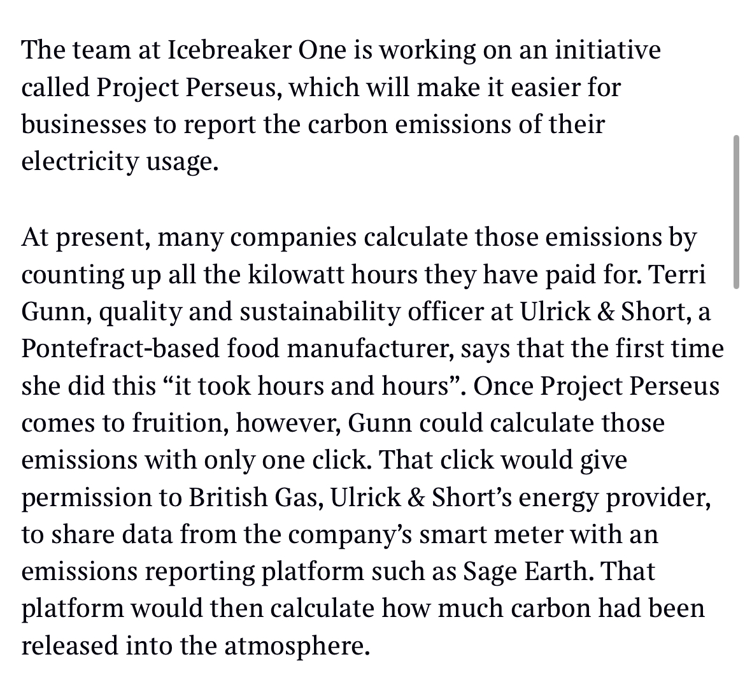
Progress so far: high-level recognition + early adoption success story
Early adoption success story
Development Bank of Wales using Perseus-enabled data as part of loan due diligence process
Legal, technical and compliance teams all agreed
Explicit SME permission throughout
Ready for national-scale implementation

Slide 21
What next?
Add a call to action here appropriate for your colleagues/audience - for example:
Attend a specific event
Explore joining the Pilot
Join Perseus
Renew membership of Perseus

